Slide 1
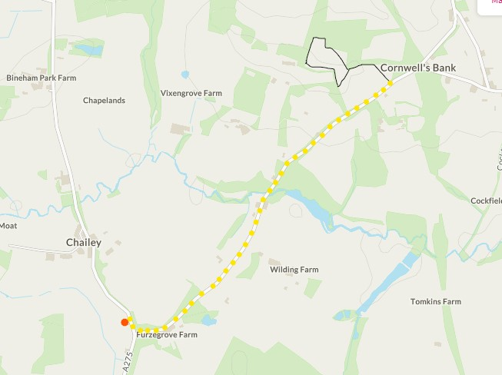
Earth Camp
Cinder Hill
The Five Bells Pub
20 minute road walk to The Five Bells pub

