Slide 1
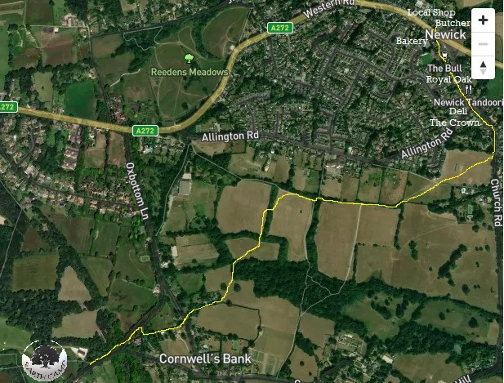
Walk to Newick
Turn left out of the Earth Camp Entrance onto Cinder Hill.
Walk down the left fork in the road, then look out for the footpath on the right-hand side, just after Sandrock (the first house).
Follow the footpath until you get to the narrow road.
Cross the road & walk past the railway carriage to the steep field.
Walk down the field to the style at the bottom.
Walk across the next small field, then up the large field to the top & follow it to the right-hand corner.
Follow the footpath to the right until you reach the rugby pitch.
Cross diagonally right, then same again across the cricket pitch to the style.
Turn left along Church road. The
Cricket pitch & playground
Rugby pitch
Footpath starts after ‘Sandrock’
Cinder Hill
100+ year old railway carriage
Crown is 1 min on the left, followed by the Pantry (deli). The Royal Oak is 1 min further on the right, followed by the Bull. The local bakery is just past the Bull, and the local convenience store, butcher & pharmacy are just across the main road.

Slide 2
